Slide 1
POS Tags and HMMs
USC VSoE CSCI 544: Applied Natural Language Processing
Jonathan May -- 梅約納
Nanyun (Violet) Peng -- 彭楠赟
September 7, 2018
based on slides of Nathan Schneider / Sharon Goldwater / Philipp Koehn

Slide 2
Reminders
HW1 is due today, by 11:59pm (modulo late days)
HW3 (project proposal) will come out this coming Wednesday (9/12)
HW2 is due next Friday (9/14)
Start thinking about the midterm (10/5; 4 weeks from today)
Don't let the reading slip: make sure you have the latest schedule
https://www.isi.edu/~jonmay/cs544_fa18_web/ (or go to jonmay.net)

Slide 3
What is Part of Speech (POS) Tagging?
Given a string This is a simple sentence
Identify parts of speech (syntactic categories) This/DET is/VB a/DET simple/ADJ sentence/NOUN

Slide 4
Why do we care about POS tagging?
First step toward full syntactic analysis (which is a first step toward full semantic analysis)
simpler and faster than full syntactic parsing
often good features for other tasks (e.g. sentiment classification, word sense disambiguation)
Good pedagogical tool for me: illustrates Hidden Markov Models (HMMs) which are used for other sequence labeling tasks

Slide 5
Other sequence labeling tasks
Named Entity Recognition (NER): label words as beginning to persons (PER), organizations (ORG), locations (LOC), or none of the above
Barack/PER Obama/PER spoke/N from/N the/N White/LOC House/LOC today/N ./N
Information field segmentation: Given specific text type (e.g. classified ad), find which words belong to which "fields" for db creation (price/size/location, author/title/year)
3BR/SIZE apt/TYPE in/N West/LOC Adams/LOC ,/N near/LOC USC/LOC ./N Bright/FEAT ,/N well/FEAT maintained/FEAT ...

Slide 6
Sequence Labeling: Key Features
In all of these, deciding the correct label depends on
The word to be labeled
NER: Smith is probably a person
POS: chair is probably a noun
The labels of surrounding words
NER: if following word is an organization (e.g. Corp.), then this word is more likely to be an organization
POS: if preceding word is a modal verb (e.g. will), then this word is more likely to be a verb
HMM combines these sources probabilistically

Slide 7
Parts of Speech
Open class words ("content words")
nouns, verbs, adjectives, adverbs
mostly content-bearing. refer to objects, actions, features in the world
open class = there is no limit to what they are or can describe so new ones are added all the time (email, website, defenestrate)
Closed class words ("function words")
pronouns, determiners, prepositions, connectives
there are a limited number of these
mostly functional: to tie the concepts of a sentence together

Slide 8
How Many Parts of Speech Are There?
Linguistic and practical considerations
If we're being empirical (we are), corpus annotators decide
proper nouns vs common nouns?
singluar vs plural nouns?
past and present tense verbs?
auxiliary and main verbs?
Commonly used tag sets for English usually have 40-100 tag types. The Penn Treebank has 45 tags.

Slide 10
POS Tags in other languages
Morphologically rich languages often have compound morphosyntactic tags Noun+A3sg+P2sg+Nom
Hundreds or thousands of possible combinations
Predicting these requires more complex methods than what's in today's lecture
e.g. soft morphological segmentation (with FST?) + disambiguation

Slide 11
Why is POS tagging hard?
Ambiguity
glass of water/NOUN vs water/VERB the plants
lie/VERB down vs tell a lie/NOUN
wind/VERB down vs a mighty wind/NOUN
Sparse data
Words we haven't seen before (at all, in this context)
Word-Tag pairs we haven't seen before (e.g. if we verb a noun)
(homographs)
time | flies | like | an | arrow
NOUN | VERB | MODAL | DET | NOUN
VERB | NOUN
ADJ | NOUN | VERB

Slide 12
Relevant knowledge for POS tagging
Remember, we want a model that decides tags based on
The word itself
Some words may be only nouns e.g. arrow
Some words are ambiguous e.g. like, flies
Probabilities may help if one tag is more likely than another
Tags of surrounding words
Two determiners rarely follow each other
Two base form verbs rarely follow each other
Determiner is almost always followed by adjective or noun
What might be a problem with putting this information in the models from last lecture?

Slide 13
A Probabilistic Model for Tagging
We have a word sequence and we want a tag sequence for those words:
P(T|W) ...guess how we're going to represent this again
P(T|W) = P(W, T)/P(W); P(W, T) = P(T|W)P(W)
P(W, T) = P(W|T)P(T)
P(T|W) = P(W|T)P(T)/P(W)
argmax_{T} P(T|W) = argmax_{T}P(W|T)P(T)/P(W)
argmax_{T} P(T|W) = argmax_{T}P(W|T)P(T)
Note, btw, that P(W|T)P(T) = P(W, T)

Slide 14
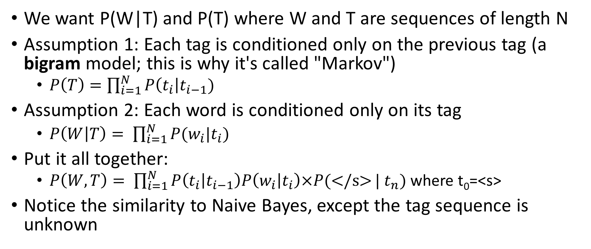
Simplifying Assumptions
We want P(W|T) and P(T) where W and T are sequences of length N
Assumption 1: Each tag is conditioned only on the previous tag (a bigram model; this is why it's called "Markov")
$P\left(T\right)=\prod_{i=1}^{N}{P\left(t_{i}\right|t_{i−1})}$
Assumption 2: Each word is conditioned only on its tag
$P\left(W | T\right)= \prod_{i=1}^{N}{P(w_{i}|t_{i})}$
Put it all together:
$P\left(W,T\right)= \prod_{i=1}^{N}{P\left(t_{i} | t_{i−1}\right)P\left(w_{i} | t_{i}\right)×P(\text{</}\text{s}\text{>}}| t_{n})$ where t₀=<s>
Notice the similarity to Naive Bayes, except the tag sequence is unknown

Slide 15
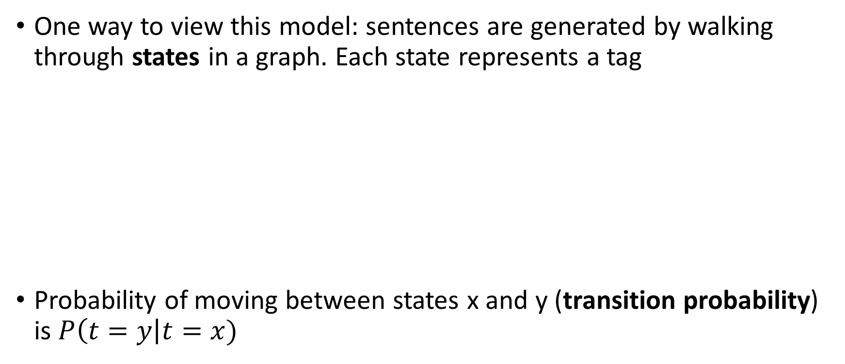
Connection to Probabilistic FSA
One way to view this model: sentences are generated by walking through states in a graph. Each state represents a tag
Probability of moving between states x and y (transition probability) is $P\left(t=y\right|t=x)$

Slide 16
Example Transition Probabilities
Table excerpted from J&M draft 3rd edition, Fig. 8.5
Probabilities estimated from WSJ corpus showing, e.g.:
Proper Nouns (NNP) often begin sentences: P(NNP|<s>) = 0.28
Modal Verbs (MD) nearly always followed by bare verbs (VB)
Adjectives (JJ) are often followed by nouns

Slide 17
Example Transition Probabilities
Table excerpted from J&M draft 3rd edition, Fig. 8.5
Table is incomplete in 2 ways. How?
All categories should be represented
Sum of rows should = 1

Slide 18

Connection to Probabilistic FST
Tag FSA outputs a tag; tag-to-word FST generates a word based on the tag
weight on x:y = $P(w=y|t=x)$, i.e. the emission probability

Slide 19
Example Emission Probabilities
Table excerpted from J&M draft 3rd edition, Fig. 8.6
MLE probabilities from tagged WSJ corpus showing, e.g.
0.0032% of proper nouns are Janet: P(Janet|NNP) = 0.000032
About half of determiners are the
the can also be a proper noun (Annotation error?)
Again, in full table, rows would sum to 1

Slide 20
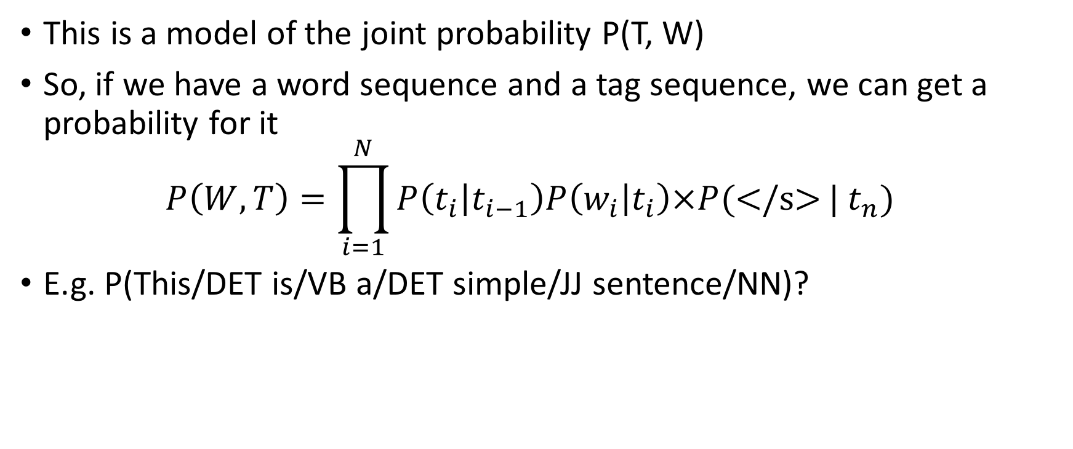
What can we do with this model?
This is a model of the joint probability P(T, W)
So, if we have a word sequence and a tag sequence, we can get a probability for it $P\left(W,T\right)=\prod_{i=1}^{N}{P\left(t_{i} | t_{i−1}\right)P\left(w_{i} | t_{i}\right)×P(\text{</}\text{s}\text{>}}| t_{n})$
E.g. P(This/DET is/VB a/DET simple/JJ sentence/NN)?
<s> | This | is | a | simple | sentence | </s>
<s> | DET | VB | DET | JJ | NN | </s>
 | P(DET|<s>) | P(VB|DET) | P(DET|VB) | P(JJ|DET) | P(NN|JJ) | P(</s>|NN)
 | p(This|DET) | P(is|VB) | P(a|DET) | P(simple|JJ) | P(sentence|NN)

Slide 21
How to tag an unlabeled sequence?
Let's say we're just given "This is a simple sentence"
Recall, in this formulation, we derived P(T, W) in order to solve argmax_{T} P(T)P(W|T)
So try "DT DT DT DT DT", "DT DT DT DT NN", ....
There are 45 tags. How many sequences will we try?
45⁵=184,528,125

Slide 22
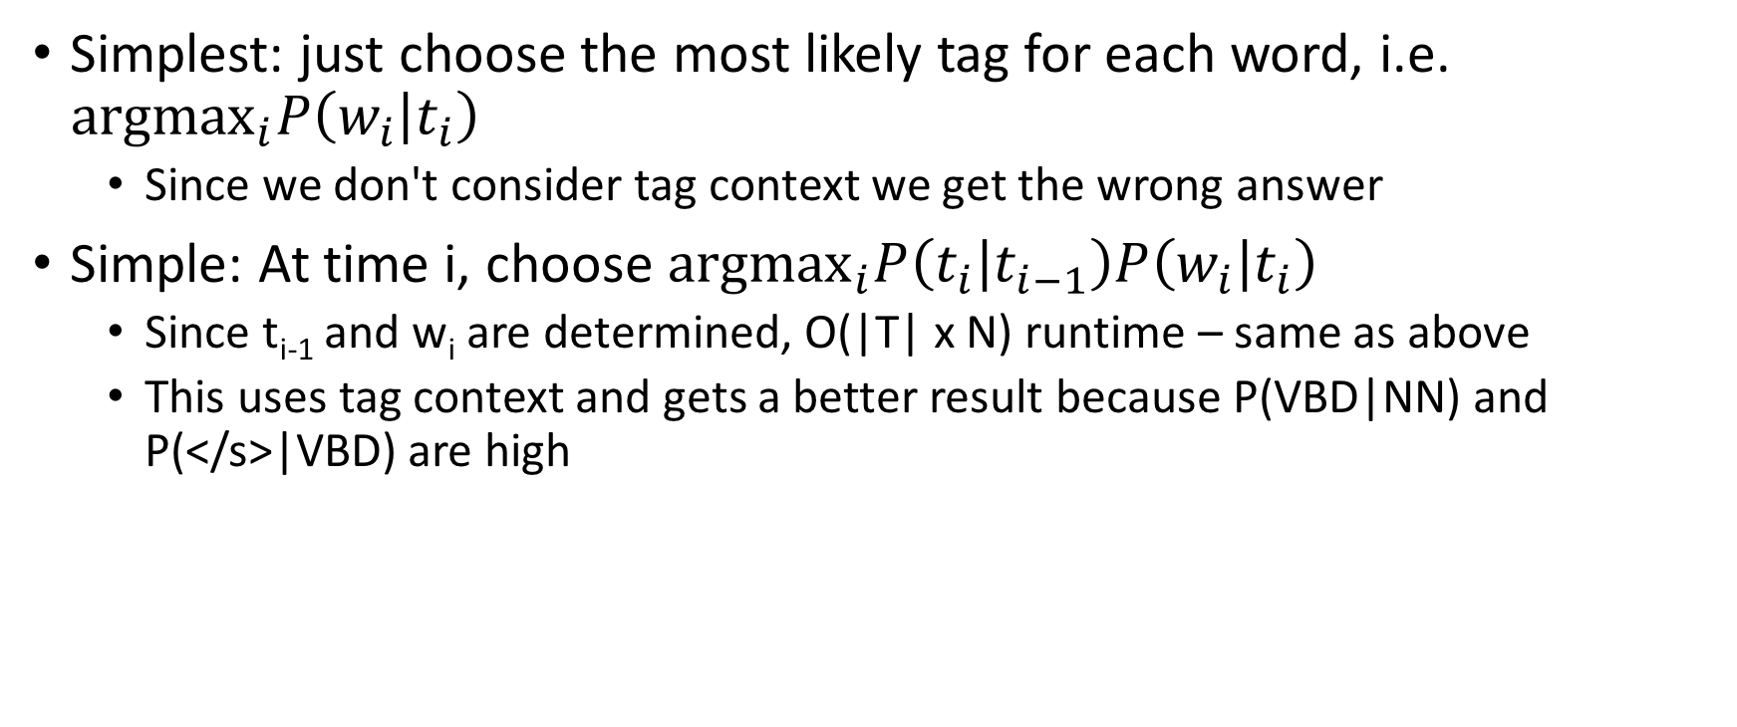
Greedy Algorithm
<s> | one | dog | bit | </s>
<s> | CD | NN | NN | </s>
 | NN | VB | VBD
 | PRP
tags ordered by
frequency for each word
Simplest: just choose the most likely tag for each word, i.e. ${\text{argmax}}_{i}P\left(w_{i} | t_{i}\right)$
Since we don't consider tag context we get the wrong answer
Simple: At time i, choose ${\text{argmax}}_{i}P\left(t_{i} | t_{i−1}\right)P\left(w_{i} | t_{i}\right)$
Since t_{i-1} and w_{i} are determined, O(|T| x N) runtime – same as above
This uses tag context and gets a better result because P(VBD|NN) and P(</s>|VBD) are high

Slide 23
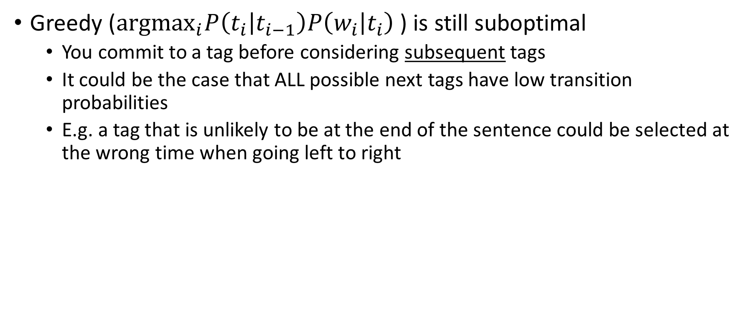
Greedy Algorithm
<s> | one | dog | bit | </s>
<s> | CD | NN | NN | </s>
 | NN | VB | VBD
 | PRP
tags ordered by
frequency for each word
Greedy (${\text{argmax}}_{i}P\left(t_{i} | t_{i−1}\right)P\left(w_{i} | t_{i}\right)$) is still suboptimal
You commit to a tag before considering subsequent tags
It could be the case that ALL possible next tags have low transition probabilities
E.g. a tag that is unlikely to be at the end of the sentence could be selected at the wrong time when going left to right

Slide 24
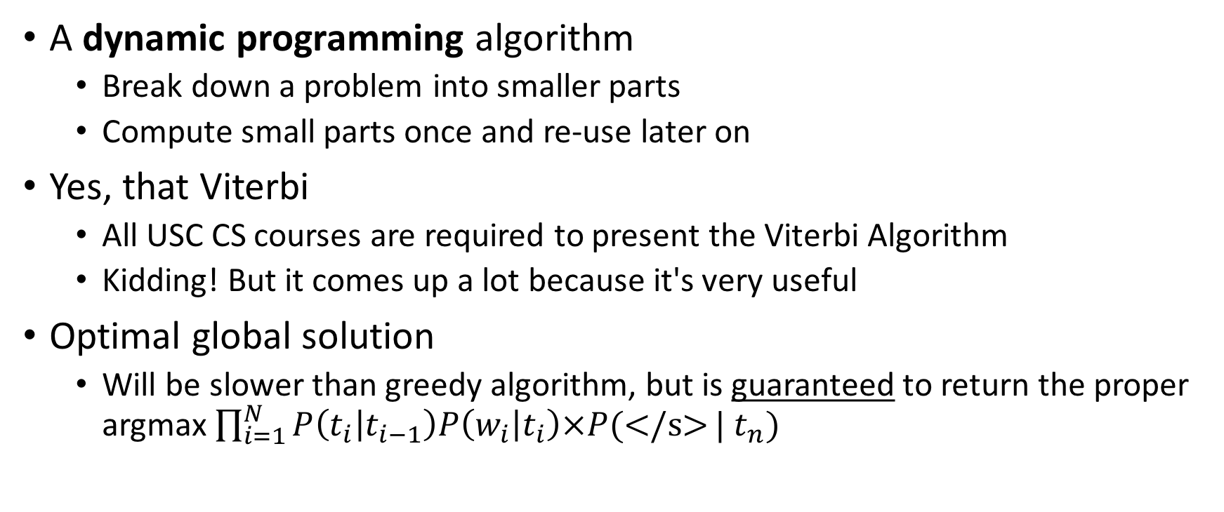
The Viterbi Algorithm
A dynamic programming algorithm
Break down a problem into smaller parts
Compute small parts once and re-use later on
Yes, that Viterbi
All USC CS courses are required to present the Viterbi Algorithm
Kidding! But it comes up a lot because it's very useful
Optimal global solution
Will be slower than greedy algorithm, but is guaranteed to return the proper argmax $\prod_{i=1}^{N}{P\left(t_{i} | t_{i−1}\right)P\left(w_{i} | t_{i}\right)×P(\text{</}\text{s}\text{>}}| t_{n})$

Slide 25
Viterbi as a Decoder
The problem of finding the best tag sequence for a given word sequence is sometimes called decoding
This is because, like spelling correction, etc., HMM can also be viewed as a noisy channel model:
Someone wants to send us a sequence of tags P(T)
During transmission, "noise" converts each tag to a word P(W|T)
We try to decode the observed words back to the original tags
Decoding is a general term in NLP for inferring hidden variables in a test instance (e.g. finding correct spelling of a misspelled word, determining topic or sentiment of an input, determining the underlying syntactic tree)

Slide 26
Viterbi Intuition
<s> | one | dog | bit | </s>
<s> | CD | NN | NN | </s>
 | NN | VB | VBD
 | PRP
tags ordered by
frequency for each word
Suppose we have already calculated
the best tag sequence for <s> ... bit that ends in NN
the best tag sequence for <s> ... bit that ends in VBD
Then, the best sequence would be either
sequence a) extended to include </s> or
sequence b) extended to include </s>

Slide 27
Viterbi Intuition
<s> | one | dog | bit | </s>
<s> | CD | NN | NN | </s>
 | NN | VB | VBD
 | PRP
tags ordered by
frequency for each word
But to get
the best tag sequence for <s> ... bit that ends in NN
Then we have to extend one of:
The best tag sequence for <s> ... dog that ends in NN
The best tag sequence for <s> ... dog that ends in VB
And so on...

Slide 28
Viterbi High-Level Picture
Want to find argmax_{T}P(T|W) = argmax_{T}P(T,W) = argmax_{T}P(T)P(W|T)
Intuition: the best path of length i ending in state t must include the best path of length i-1 to the previous state. So,
find the best path of length i-1 to each state
consider extending each of these by 1 step, to state t
take the best of these options as the best path to state t

Slide 29
Viterbi Algorithm
use a chart v to store partial results as we go
T x N table for T possible tags and length N sentence
v[t, i] is the probability of the best state sequence for w₁...w_{i} that ends in state t
fill columns left to right, with
v[t, i] = max_{t'} v[t', i-1] x P(t|t') x P(w_{i}|t_{i})
note, the max is over each possible previous tag t'
also keep a backtrace table b
b[t, i] = argmax_{t'} v[t', i-1] x P(t|t') x P(w_{i}|t_{i})
b can be used afterward to find the chain of tags

Slide 30
Example
v | w₁=the | w₂=doctor | w₃=is | w₄=in | </s>
N
V
D
P
A
Suppose W = the doctor is in. Our chart is initially empty.
T->T | N | V | D | P | A | </s>
<s> | .3 | .1 | .3 | .2 | .1 | 0
N | .2 | .4 | .01 | .3 | .04 | .05
V | .3 | .05 | .3 | .2 | .1 | .05
D | .9 | .01 | .01 | .01 | .07 | 0
P | .4 | .05 | .4 | .1 | .05 | 0
A | .1 | .5 | .1 | .1 | .1 | .1
T->W | a | cat | doctor | in | is | the | very
N | 0 | .5 | .4 | 0 | .1 | 0 | 0
V | 0 | 0 | .1 | 0 | .9 | 0 | 0
D | .3 | 0 | 0 | 0 | 0 | .7 | 0
P | 0 | 0 | 0 | 1 | 0 | 0 | 0
A | 0 | 0 | 0 | .1 | 0 | 0 | .9

Slide 31
Example
v | w₁=the | w₂=doctor | w₃=is | w₄=in | </s>
N
V
D
P
A
Suppose W = the doctor is in. Our chart is initially empty.
T->T | N | V | D | P | A | </s>
<s> | .3 | .1 | .3 | .2 | .1 | 0
N | .2 | .4 | .01 | .3 | .04 | .05
V | .3 | .05 | .3 | .2 | .1 | .05
D | .9 | .01 | .01 | .01 | .07 | 0
P | .4 | .05 | .4 | .1 | .05 | 0
A | .1 | .5 | .1 | .1 | .1 | .1
T->W | doctor | in | is | the
N | .4 | 0 | .1 | 0
V | .1 | 0 | .9 | 0
D | 0 | 0 | 0 | .7
P | 0 | 1 | 0 | 0
A | 0 | .1 | 0 | 0

Slide 32
Filling in the First Column
v | w₁=the | w₂=doctor | w₃=is | w₄=in | </s>
N | 0
V | 0
D | .21
P | 0
A | 0
v[N,the] = P(N|<s>)*P(the|N) = .3*0=0
...
v[D,the] = P(D|<s>)*P(the|D) = .3*.7=.21
T->T | N | V | D | P | A | </s>
<s> | .3 | .1 | .3 | .2 | .1 | 0
N | .2 | .4 | .01 | .3 | .04 | .05
V | .3 | .05 | .3 | .2 | .1 | .05
D | .9 | .01 | .01 | .01 | .07 | 0
P | .4 | .05 | .4 | .1 | .05 | 0
A | .1 | .5 | .1 | .1 | .1 | .1
T->W | doctor | in | is | the
N | .4 | 0 | .1 | 0
V | .1 | 0 | .9 | 0
D | 0 | 0 | 0 | .7
P | 0 | 1 | 0 | 0
A | 0 | .1 | 0 | 0

Slide 33
Second Column
v | w₁=the | w₂=doctor | w₃=is | w₄=in | </s>
N | 0 | ?
V | 0
D | .21
P | 0
A | 0
v[N,doctor] = max_{t'} v[t',the]*P(N|t')*P(doctor|N)
max(0,0,.21*.9*.4.,0,0) = .0756
T->T | N | V | D | P | A | </s>
<s> | .3 | .1 | .3 | .2 | .1 | 0
N | .2 | .4 | .01 | .3 | .04 | .05
V | .3 | .05 | .3 | .2 | .1 | .05
D | .9 | .01 | .01 | .01 | .07 | 0
P | .4 | .05 | .4 | .1 | .05 | 0
A | .1 | .5 | .1 | .1 | .1 | .1
T->W | doctor | in | is | the
N | .4 | 0 | .1 | 0
V | .1 | 0 | .9 | 0
D | 0 | 0 | 0 | .7
P | 0 | 1 | 0 | 0
A | 0 | .1 | 0 | 0
P(N|D)*P(doctor|N) = .9*.4

Slide 34
Second Column
v | w₁=the | w₂=doctor | w₃=is | w₄=in | </s>
N | 0 | .0756
V | 0
D | .21
P | 0
A | 0
v[N,doctor] = max_{t'} v[t',the]*P(N|t')*P(doctor|N)
max(0,0,.21*.9*.4.,0,0) = .0756
T->T | N | V | D | P | A | </s>
<s> | .3 | .1 | .3 | .2 | .1 | 0
N | .2 | .4 | .01 | .3 | .04 | .05
V | .3 | .05 | .3 | .2 | .1 | .05
D | .9 | .01 | .01 | .01 | .07 | 0
P | .4 | .05 | .4 | .1 | .05 | 0
A | .1 | .5 | .1 | .1 | .1 | .1
T->W | doctor | in | is | the
N | .4 | 0 | .1 | 0
V | .1 | 0 | .9 | 0
D | 0 | 0 | 0 | .7
P | 0 | 1 | 0 | 0
A | 0 | .1 | 0 | 0
P(N|D)*P(doctor|N) = .9*.4

Slide 35
Second Column
v | w₁=the | w₂=doctor | w₃=is | w₄=in | </s>
N | 0 | .0756
V | 0 | .00021
D | .21
P | 0
A | 0
v[V,doctor] = max_{t'} v[t',the]*P(V|t')*P(doctor|V)
max(0,0,.21*.01*.1,0,0) = .00021
T->T | N | V | D | P | A | </s>
<s> | .3 | .1 | .3 | .2 | .1 | 0
N | .2 | .4 | .01 | .3 | .04 | .05
V | .3 | .05 | .3 | .2 | .1 | .05
D | .9 | .01 | .01 | .01 | .07 | 0
P | .4 | .05 | .4 | .1 | .05 | 0
A | .1 | .5 | .1 | .1 | .1 | .1
T->W | doctor | in | is | the
N | .4 | 0 | .1 | 0
V | .1 | 0 | .9 | 0
D | 0 | 0 | 0 | .7
P | 0 | 1 | 0 | 0
A | 0 | .1 | 0 | 0

Slide 36
Second Column
v | w₁=the | w₂=doctor | w₃=is | w₄=in | </s>
N | 0 | .0756
V | 0 | .00021
D | .21 | 0
P | 0 | 0
A | 0 | 0
T->T | N | V | D | P | A | </s>
<s> | .3 | .1 | .3 | .2 | .1 | 0
N | .2 | .4 | .01 | .3 | .04 | .05
V | .3 | .05 | .3 | .2 | .1 | .05
D | .9 | .01 | .01 | .01 | .07 | 0
P | .4 | .05 | .4 | .1 | .05 | 0
A | .1 | .5 | .1 | .1 | .1 | .1
T->W | doctor | in | is | the
N | .4 | 0 | .1 | 0
V | .1 | 0 | .9 | 0
D | 0 | 0 | 0 | .7
P | 0 | 1 | 0 | 0
A | 0 | .1 | 0 | 0

Slide 37
Third Column
v | w₁=the | w₂=doctor | w₃=is | w₄=in | </s>
N | 0 | .0756 | .001512
V | 0 | .00021
D | .21 | 0
P | 0 | 0
A | 0 | 0
v[N,is] = max_{t'} v[t',doctor]*P(N|t')*P(is|N)
.0756 * .2 * .1 = .001512
T->T | N | V | D | P | A | </s>
<s> | .3 | .1 | .3 | .2 | .1 | 0
N | .2 | .4 | .01 | .3 | .04 | .05
V | .3 | .05 | .3 | .2 | .1 | .05
D | .9 | .01 | .01 | .01 | .07 | 0
P | .4 | .05 | .4 | .1 | .05 | 0
A | .1 | .5 | .1 | .1 | .1 | .1
T->W | doctor | in | is | the
N | .4 | 0 | .1 | 0
V | .1 | 0 | .9 | 0
D | 0 | 0 | 0 | .7
P | 0 | 1 | 0 | 0
A | 0 | .1 | 0 | 0
.00021 * .3 * .1 = .0000063
0* .9 * .1 = 0

Slide 38
Third Column
v | w₁=the | w₂=doctor | w₃=is | w₄=in | </s>
N | 0 | .0756 | .001512
V | 0 | .00021 | .027216
D | .21 | 0 | 0
P | 0 | 0 | 0
A | 0 | 0 | 0
v[V,is] = max_{t'} v[t',doctor]*P(V|t')*P(is|V)
max(.0756*.4*.9, .00021*.05*.9,
0,
0,
0) = .027216
T->T | N | V | D | P | A | </s>
<s> | .3 | .1 | .3 | .2 | .1 | 0
N | .2 | .4 | .01 | .3 | .04 | .05
V | .3 | .05 | .3 | .2 | .1 | .05
D | .9 | .01 | .01 | .01 | .07 | 0
P | .4 | .05 | .4 | .1 | .05 | 0
A | .1 | .5 | .1 | .1 | .1 | .1
T->W | doctor | in | is | the
N | .4 | 0 | .1 | 0
V | .1 | 0 | .9 | 0
D | 0 | 0 | 0 | .7
P | 0 | 1 | 0 | 0
A | 0 | .1 | 0 | 0

Slide 39
Fourth Column
v | w₁=the | w₂=doctor | w₃=is | w₄=in | </s>
N | 0 | .0756 | .001512 | 0
V | 0 | .00021 | .027216 | 0
D | .21 | 0 | 0 | 0
P | 0 | 0 | 0 | .0054432
A | 0 | 0 | 0
v[P,in] = max_{t'} v[t',is]*P(P|t')*P(in|P)
max(.001512*.3*1, .027216*.2*1,
0,
0,
0) = .0054432
T->T | N | V | D | P | A | </s>
<s> | .3 | .1 | .3 | .2 | .1 | 0
N | .2 | .4 | .01 | .3 | .04 | .05
V | .3 | .05 | .3 | .2 | .1 | .05
D | .9 | .01 | .01 | .01 | .07 | 0
P | .4 | .05 | .4 | .1 | .05 | 0
A | .1 | .5 | .1 | .1 | .1 | .1
T->W | doctor | in | is | the
N | .4 | 0 | .1 | 0
V | .1 | 0 | .9 | 0
D | 0 | 0 | 0 | .7
P | 0 | 1 | 0 | 0
A | 0 | .1 | 0 | 0

Slide 40
Fourth Column
v | w₁=the | w₂=doctor | w₃=is | w₄=in | </s>
N | 0 | .0756 | .001512 | 0
V | 0 | .00021 | .027216 | 0
D | .21 | 0 | 0 | 0
P | 0 | 0 | 0 | .0054432
A | 0 | 0 | 0 | .00027216
v[A,in] = max_{t'} v[t',is]*P(A|t')*P(in|A)
max(.001512*.04*.1, .027216*.1*.1,
0,
0,
0) = .00027216
T->T | N | V | D | P | A | </s>
<s> | .3 | .1 | .3 | .2 | .1 | 0
N | .2 | .4 | .01 | .3 | .04 | .05
V | .3 | .05 | .3 | .2 | .1 | .05
D | .9 | .01 | .01 | .01 | .07 | 0
P | .4 | .05 | .4 | .1 | .05 | 0
A | .1 | .5 | .1 | .1 | .1 | .1
T->W | doctor | in | is | the
N | .4 | 0 | .1 | 0
V | .1 | 0 | .9 | 0
D | 0 | 0 | 0 | .7
P | 0 | 1 | 0 | 0
A | 0 | .1 | 0 | 0

Slide 41
End of sentence
v | w₁=the | w₂=doctor | w₃=is | w₄=in | </s>
N | 0 | .0756 | .001512 | 0 | .000027216
V | 0 | .00021 | .027216 | 0
D | .21 | 0 | 0 | 0
P | 0 | 0 | 0 | .0054432
A | 0 | 0 | 0 | .00027216
v[</s>] = max_{t'} v[t',in]*P(</s>|t')
T->T | N | V | D | P | A | </s>
<s> | .3 | .1 | .3 | .2 | .1 | 0
N | .2 | .4 | .01 | .3 | .04 | .05
V | .3 | .05 | .3 | .2 | .1 | .05
D | .9 | .01 | .01 | .01 | .07 | 0
P | .4 | .05 | .4 | .1 | .05 | 0
A | .1 | .5 | .1 | .1 | .1 | .1
max(0, 0,
0,
.0054432*0,
.00027216*.1) = .000027216
T->W | doctor | in | is | the
N | .4 | 0 | .1 | 0
V | .1 | 0 | .9 | 0
D | 0 | 0 | 0 | .7
P | 0 | 1 | 0 | 0
A | 0 | .1 | 0 | 0

Slide 42
Completed Chart
v | w₁=the | w₂=doctor | w₃=is | w₄=in | </s>
N | 0 | .0756 | .001512 | 0 | .000027216
V | 0 | .00021 | .027216 | 0
D | .21 | 0 | 0 | 0
P | 0 | 0 | 0 | .0054432
A | 0 | 0 | 0 | .00027216
T->T | N | V | D | P | A | </s>
<s> | .3 | .1 | .3 | .2 | .1 | 0
N | .2 | .4 | .01 | .3 | .04 | .05
V | .3 | .05 | .3 | .2 | .1 | .05
D | .9 | .01 | .01 | .01 | .07 | 0
P | .4 | .05 | .4 | .1 | .05 | 0
A | .1 | .5 | .1 | .1 | .1 | .1
T->W | doctor | in | is | the
N | .4 | 0 | .1 | 0
V | .1 | 0 | .9 | 0
D | 0 | 0 | 0 | .7
P | 0 | 1 | 0 | 0
A | 0 | .1 | 0 | 0

Slide 43
Following the Backtraces
v | w₁=the | w₂=doctor | w₃=is | w₄=in | </s>
N | 0 | .0756 | .001512 | 0 | .000027216
V | 0 | .00021 | .027216 | 0
D | .21 | 0 | 0 | 0
P | 0 | 0 | 0 | .0054432
A | 0 | 0 | 0 | .00027216
D
N
V
A
T->T | N | V | D | P | A | </s>
<s> | .3 | .1 | .3 | .2 | .1 | 0
N | .2 | .4 | .01 | .3 | .04 | .05
V | .3 | .05 | .3 | .2 | .1 | .05
D | .9 | .01 | .01 | .01 | .07 | 0
P | .4 | .05 | .4 | .1 | .05 | 0
A | .1 | .5 | .1 | .1 | .1 | .1
T->W | doctor | in | is | the
N | .4 | 0 | .1 | 0
V | .1 | 0 | .9 | 0
D | 0 | 0 | 0 | .7
P | 0 | 1 | 0 | 0
A | 0 | .1 | 0 | 0

Slide 44
Do Transition and Emission Probabilities Need Smoothing?
Emissions: Yes, because if there is any word w in the test data such that P(w|t) = 0 for all tags t, then the whole joint probability P(W, T) will go to 0.
Transitions: Not necessarily, but if any transition probabilities are estimated as 0, that tag bigram will never be predicted
You generally won't add OOV to smooth transitions, since all labels are known ahead of time
What are some transitions that should NEVER occur in a bigram HMM?
* ➜ <s>
</s> ➜ *
<s> ➜ </s>

Slide 45
Higher-Order HMMs
Equations thus far have been for bigram HMMs, i.e. transitions P(t_{i}|t_{i-1})
But we can increase the order of the n-gram (i.e. n > 2). e.g. trigram HMMs = P(t_{i}|t_{i-1},t_{i-2}) [see collins notes]
As usual, smoothing the transition distributions becomes more important with higher-order models

Slide 46
What Else Can we do?
Suppose you want to find the likelihood of an input sequence, P(W)
The HMM models P(T, W); by law of total probability sum over all T and you get P(W)
Why do you want to do this?
If you have a high P(W) that means your model likes your data; if your data is good data, it's an indication you have a good model
There are an exponential number of members of T
We can use the forward algorithm, which is very similar to Viterbi
Replace max with sum (no backpointers needed)

Slide 47
Second Column, Viterbi Algorithm
v | w₁=the | w₂=doctor | w₃=is | w₄=in | </s>
N | 0 | .0756
V | 0
D | .21
P | 0
A | 0
v[N,doctor] = max_{t'} v[t',the]*P(N|t')*P(doctor|N)
max(0,0,.21*.9*.4.,0,0) = .0756
T->T | N | V | D | P | A | </s>
<s> | .3 | .1 | .3 | .2 | .1 | 0
N | .2 | .4 | .01 | .3 | .04 | .05
V | .3 | .05 | .3 | .2 | .1 | .05
D | .9 | .01 | .01 | .01 | .07 | 0
P | .4 | .05 | .4 | .1 | .05 | 0
A | .1 | .5 | .1 | .1 | .1 | .1
T->W | doctor | in | is | the
N | .4 | 0 | .1 | 0
V | .1 | 0 | .9 | 0
D | 0 | 0 | 0 | .7
P | 0 | 1 | 0 | 0
A | 0 | .1 | 0 | 0
P(N|D)*P(doctor|N) = .9*.4

Slide 48
Second Column, Forward Algorithm
v | w₁=the | w₂=doctor | w₃=is | w₄=in | </s>
N | 0 | .0756
V | 0
D | .21
P | 0
A | 0
v[N,doctor] = ∑_{t'} v[t',the]*P(N|t')*P(doctor|N)
∑(0,0,.21*.9*.4.,0,0) = .0756
T->T | N | V | D | P | A | </s>
<s> | .3 | .1 | .3 | .2 | .1 | 0
N | .2 | .4 | .01 | .3 | .04 | .05
V | .3 | .05 | .3 | .2 | .1 | .05
D | .9 | .01 | .01 | .01 | .07 | 0
P | .4 | .05 | .4 | .1 | .05 | 0
A | .1 | .5 | .1 | .1 | .1 | .1
T->W | doctor | in | is | the
N | .4 | 0 | .1 | 0
V | .1 | 0 | .9 | 0
D | 0 | 0 | 0 | .7
P | 0 | 1 | 0 | 0
A | 0 | .1 | 0 | 0
P(N|D)*P(doctor|N) = .9*.4

Slide 49
Third Column, Viterbi
v | w₁=the | w₂=doctor | w₃=is | w₄=in | </s>
N | 0 | .0756 | .001512
V | 0 | .00021
D | .21 | 0
P | 0 | 0
A | 0 | 0
v[N,is] = max_{t'} v[t',doctor]*P(N|t')*P(is|N)
.0756 * .2 * .1 = .001512
T->T | N | V | D | P | A | </s>
<s> | .3 | .1 | .3 | .2 | .1 | 0
N | .2 | .4 | .01 | .3 | .04 | .05
V | .3 | .05 | .3 | .2 | .1 | .05
D | .9 | .01 | .01 | .01 | .07 | 0
P | .4 | .05 | .4 | .1 | .05 | 0
A | .1 | .5 | .1 | .1 | .1 | .1
T->W | doctor | in | is | the
N | .4 | 0 | .1 | 0
V | .1 | 0 | .9 | 0
D | 0 | 0 | 0 | .7
P | 0 | 1 | 0 | 0
A | 0 | .1 | 0 | 0
.00021 * .3 * .1 = .0000063
0* .9 * .1 = 0

Slide 50
Third Column, Forward
v | w₁=the | w₂=doctor | w₃=is | w₄=in | </s>
N | 0 | .0756 | .0015183
V | 0 | .00021
D | .21 | 0
P | 0 | 0
A | 0 | 0
v[N,is] = ∑_{t'} v[t',doctor]*P(N|t')*P(is|N)
.0756 * .2 * .1 = .001512
T->T | N | V | D | P | A | </s>
<s> | .3 | .1 | .3 | .2 | .1 | 0
N | .2 | .4 | .01 | .3 | .04 | .05
V | .3 | .05 | .3 | .2 | .1 | .05
D | .9 | .01 | .01 | .01 | .07 | 0
P | .4 | .05 | .4 | .1 | .05 | 0
A | .1 | .5 | .1 | .1 | .1 | .1
+
T->W | doctor | in | is | the
N | .4 | 0 | .1 | 0
V | .1 | 0 | .9 | 0
D | 0 | 0 | 0 | .7
P | 0 | 1 | 0 | 0
A | 0 | .1 | 0 | 0
.00021 * .3 * .1 = .0000063
+
0* .9 * .1 = 0
= .0015183

Slide 51
Summary
Part-of-speech tagging is a sequence labeling task
HMM: A generative model of sentences using hidden state sequence
HMM uses two sources of information to resolve ambiguity
The words themselves
The tags of nearby words
Can be viewed as a probabilistic FSM
Algorithms for computing probability efficiently:
Greedy tagging: Fast but suboptimal
Dynamic Programming algorithms to compute
Best tag sequence given words: Viterbi algorithm
Likelihood of corpus: Forward algorithm

